Slide 1
Experimental Statistics I
Live Session Unit 10
July 11-12, 2016

Slide 2
Housekeeping Notes
Midterm
I will try to get all the midterms graded this week
Post-Live Session Homework Unit 10
Needs to be written in “report” format
See Homework description
We will start this homework in class today and your group may finish the analysis, but the write-up needs to be entirely your own!

Slide 3
Question From Unit 10
What is the difference between a confidence interval and a prediction interval

Slide 4
Confidence Intervals vs. Prediction Intervals
Confidence Interval
Prediction Interval
An interval meant to capture the mean of the population that has a specific X value.
Will always be narrower than a prediction interval at the same value.
An interval meant to capture an individual value of a randomly chosen person/thing that has a specific X value.
Will always be wider than a confidence interval at the same value.

Slide 5
Confidence Intervals vs. Prediction Intervals Example
Say we have a model of weight based on height of 12 year old boys.
Say we calculate the 95% confidence interval and 95% prediction interval of weights for height = 60 in.

Slide 6
Confidence Intervals vs. Prediction Intervals
Confidence Interval
Prediction Interval
An interval to capture the mean weight for the entire population of 12 year old boys with a height of 60 inches.
An interval to capture the weight of one randomly selected 12 year old boy with a height of 60 inches.

Slide 7
Example using PROC REG (Homework 10)
SAS Code and Output

Slide 8
Data for Homework 10
ex0727 in the Statistical Sleuth Datasets
You will need to alter the provided code for your data’s file path
Two variables:
Mass: Mean stone mass in grams
TCell: T-Cell response in mm
You can read more about this data in Exercise 27 of Chapter 7 (page 204)

Slide 9
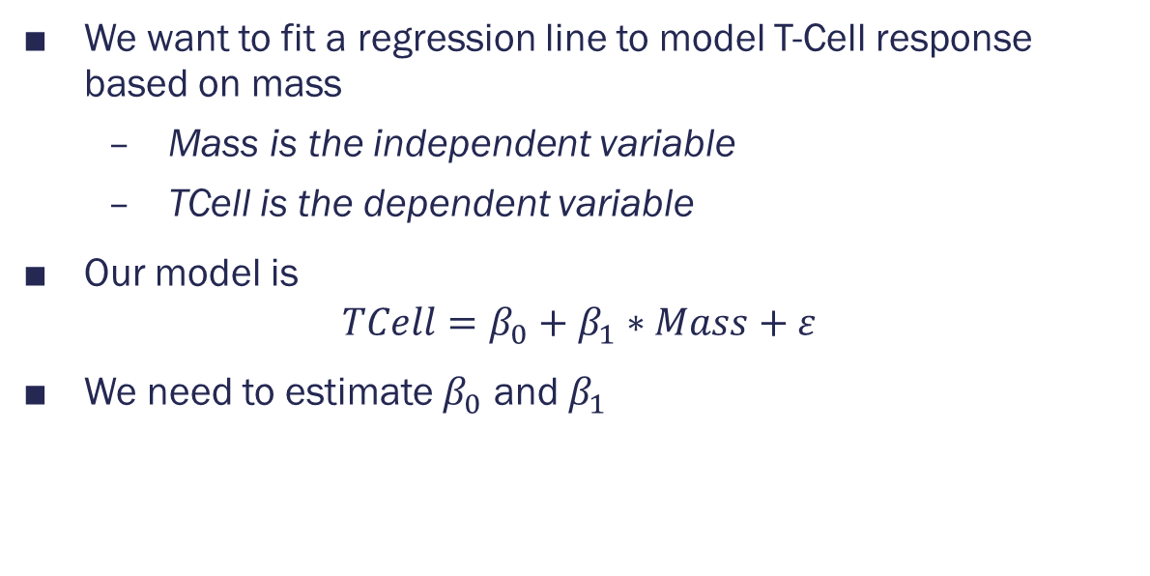
Model
We want to fit a regression line to model T-Cell response based on mass
Mass is the independent variable
TCell is the dependent variable
Our model is
$$TCell=β_{0}+β_{1}∗Mass+ε$$
We need to estimate $β_{0}$ and $β_{1}$

Slide 10
Model Fitting
The code you will need to run to fit the model in PROC REG:
proc reg data=Birds;
id Mass; *includes Mass in table;
model TCell = Mass /R CLB CLM CLI;
run;
This will give the same tables, scatterplot, and residual graphs as PROC GLM, but also a table containing
Predicted values
Residuals (R)
95% Confidence Interval for the mean at each X in the dataset (CLM)
95% Prediction Interval at each X in the dataset (CLI)

Slide 11
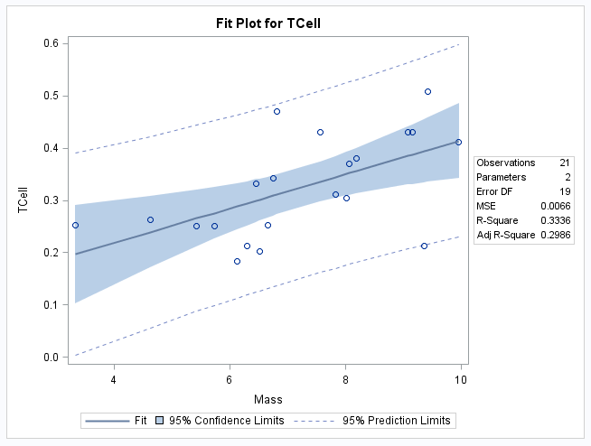
Scatter Plot

Slide 12
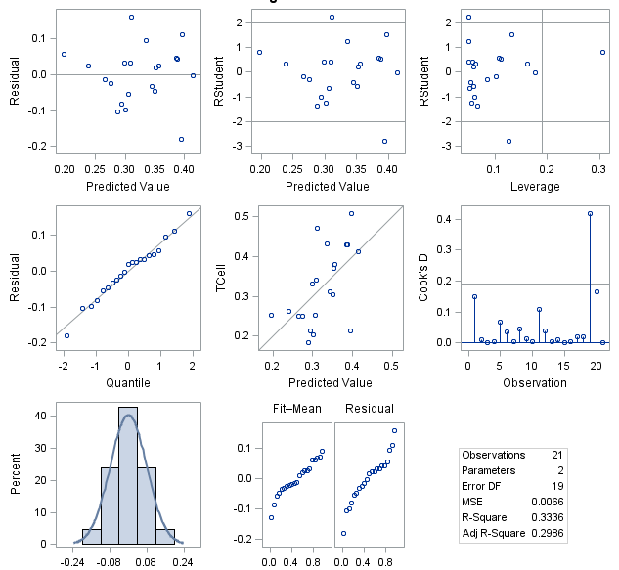
Residuals
3 graphs on the left:
Top – Residuals by predicted value
Want a random scatter
Middle – Q-Q Plot of residuals
Want close to line
Bottom – Histogram of residuals
Want to appear normally shaped
Linear Regression is appropriate

Slide 13
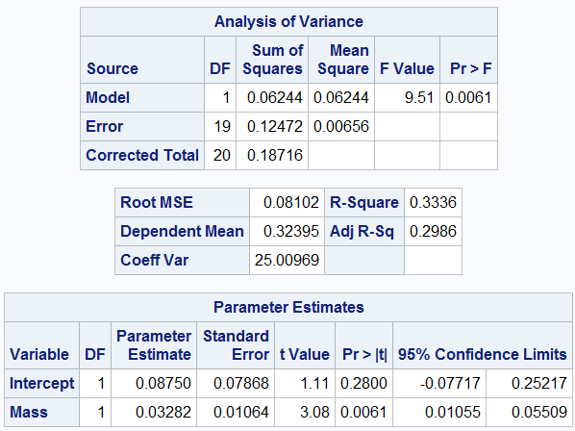
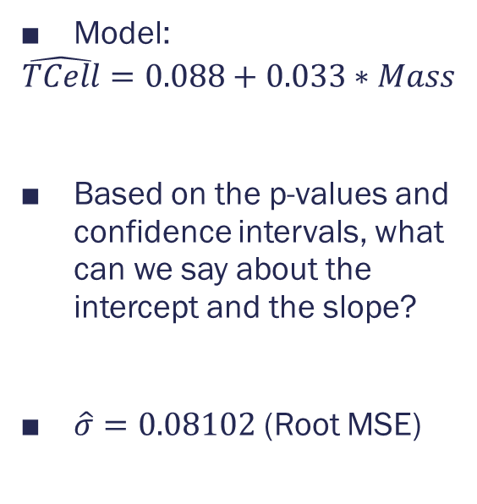
Model Fitting Results
Model:
$$\hat{TCell}=0.088+0.033∗Mass$$
Based on the p-values and confidence intervals, what can we say about the intercept and the slope?
$\hat{σ}=0.08102$ (Root MSE)
The CLB option gives the parameter CIs

Slide 14

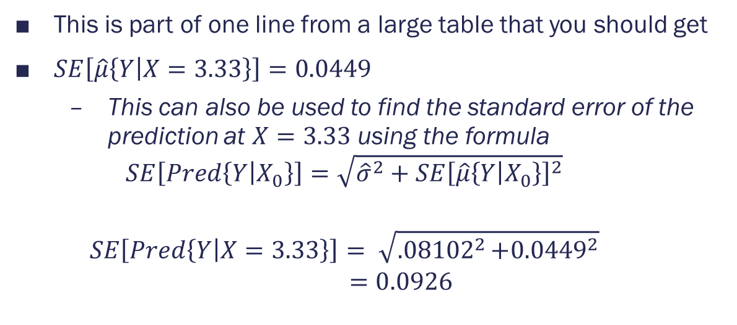
Model Fitting Results
This is part of one line from a large table that you should get
$SE\left[\hat{μ}\left\{Y | X=3.33\right\}\right]=0.0449$
This can also be used to find the standard error of the prediction at $X=3.33$ using the formula
$$SE\left[Pred\left\{Y | X_{0}\right\}\right]=\sqrt{{\hat{σ}}^{2}+SE{\left[\hat{μ}\left\{Y | X_{0}\right\}\right]}^{2}}$$
$$SE\left[Pred\left\{Y | X=3.33\right\}\right]= \sqrt{{.08102}^{2}+{0.0449}^{2}}$$
$$=0.0926$$

Slide 15
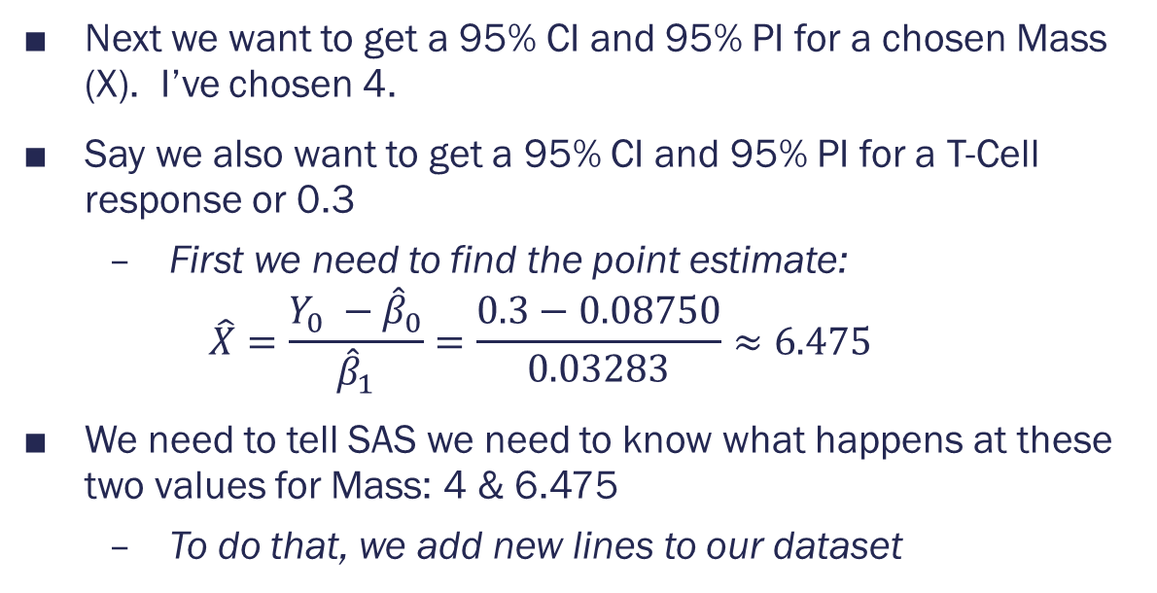
Prediction and Calibration
Next we want to get a 95% CI and 95% PI for a chosen Mass (X). I’ve chosen 4.
Say we also want to get a 95% CI and 95% PI for a T-Cell response or 0.3
First we need to find the point estimate:
$$\hat{X}=\frac{Y_{0} −{\hat{β}}_{0}}{{\hat{β}}_{1}}=\frac{0.3−0.08750}{0.03283}≈6.475$$
We need to tell SAS we need to know what happens at these two values for Mass: 4 & 6.475
To do that, we add new lines to our dataset

Slide 16
Appending Dataset
Data Birds2;
input Mass;
datalines;
4
6.475
;
run;
Data Birds2;
set Birds Birds2;
run;
The first Data step creates a new dataset, Birds2, that contains the new Mass values we want to use.
It is important to name the variable the same thing as before!
The second data step combines (appends) the two datasets
This dataset does not need to be called Birds2 as well, but since I don’t need the old Birds2, I overwrote it.
You can use PROC PRINT for the Birds2 dataset if you want to see the result.

Slide 17
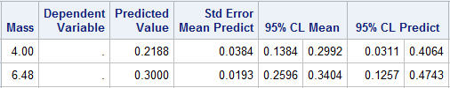
Model Fitting with Prediction
Copy and paste your previous PROC REG and change the dataset to “Birds2”.
Run it.
Everything, including the model, should be the same except the large table with predictions, etc., which should have two extra rows at the bottom

Slide 18
Prediction for Mass = 4
For the population of birds carrying stones of a weight of 4 g, we are 95% confident that the mean T-Cell response is between 0.1384 and 0.2992 mm.
For a randomly selected individual bird carrying a stone of weight 4 g, we are 95% confident that its T-Cell response is between 0.0311 and 0.4064

Slide 19
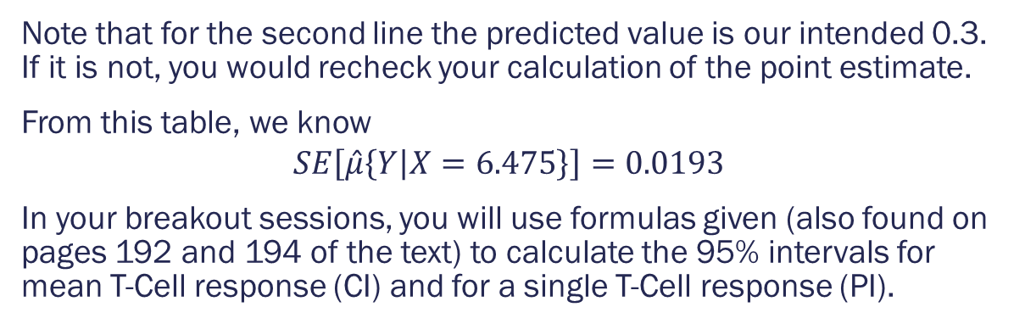
Calibration for TCell = 0.3 (with estimate Mass = 6.475)
Note that for the second line the predicted value is our intended 0.3. If it is not, you would recheck your calculation of the point estimate.
From this table, we know
$$SE\left[\hat{μ}\left\{Y | X=6.475\right\}\right]=0.0193$$
In your breakout sessions, you will use formulas given (also found on pages 192 and 194 of the text) to calculate the 95% intervals for mean T-Cell response (CI) and for a single T-Cell response (PI).

Slide 20
Breakout Sessions
First, work through the calculation of the calibration intervals for Post Live Session Homework Unit 10.
I have helped you along with the formulas and calculations in the slides!
After you have finished this, review the Quiz.

Slide 21
BreakOUT Sessions
Calibration Intervals from Homework 10
Review of Quiz 10

Slide 22
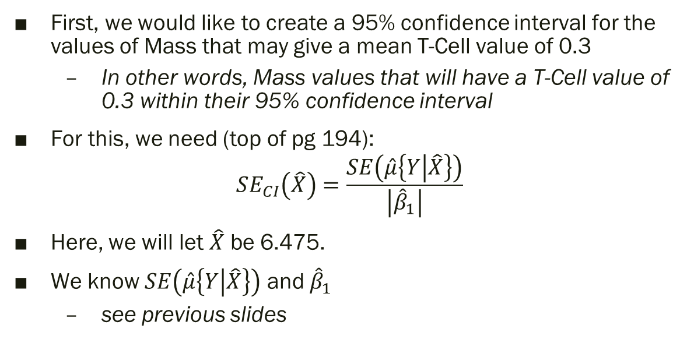
Calibration: Confidence Interval
First, we would like to create a 95% confidence interval for the values of Mass that may give a mean T-Cell value of 0.3
In other words, Mass values that will have a T-Cell value of 0.3 within their 95% confidence interval
For this, we need (top of pg 194):
$$SE_{CI}\left(\hat{X}\right)=\frac{SE\left(\hat{μ}\left\{Y | \hat{X}\right\}\right)}{\left|{\hat{β}}_{1}\right|}$$
Here, we will let $\hat{X}$ be 6.475.
We know $SE\left(\hat{μ}\left\{Y | \hat{X}\right\}\right)$ and ${\hat{β}}_{1}$
see previous slides

Slide 23
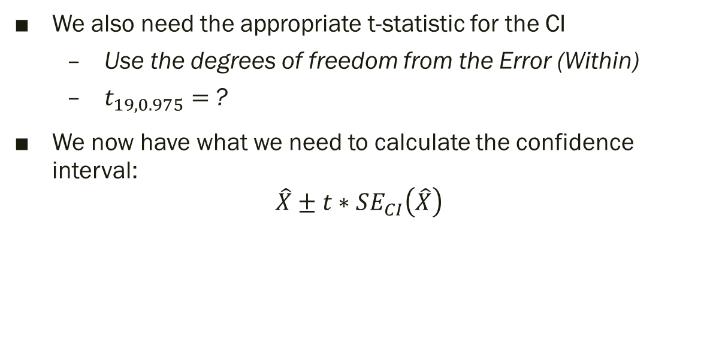
Calibration: Confidence Interval
We also need the appropriate t-statistic for the CI
Use the degrees of freedom from the Error (Within)
$t_{19,0.975}=$?
We now have what we need to calculate the confidence interval:
$$\hat{X}±t∗SE_{CI}\left(\hat{X}\right)$$

Slide 24
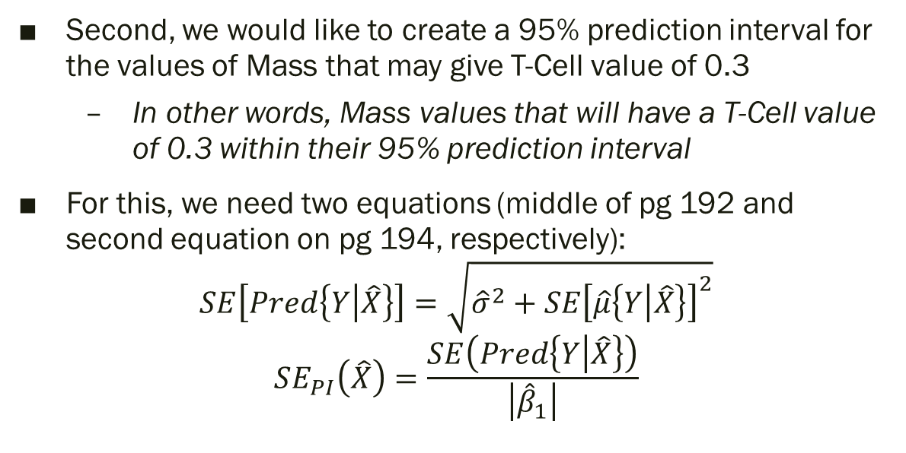
Calibration: Prediction Interval
Second, we would like to create a 95% prediction interval for the values of Mass that may give T-Cell value of 0.3
In other words, Mass values that will have a T-Cell value of 0.3 within their 95% prediction interval
For this, we need two equations (middle of pg 192 and second equation on pg 194, respectively):
$$SE\left[Pred\left\{Y | \hat{X}\right\}\right]=\sqrt{{\hat{σ}}^{2}+SE{\left[\hat{μ}\left\{Y | \hat{X}\right\}\right]}^{2}}$$
$$SE_{PI}\left(\hat{X}\right)=\frac{SE\left(Pred\left\{Y | \hat{X}\right\}\right)}{\left|{\hat{β}}_{1}\right|}$$

Slide 25
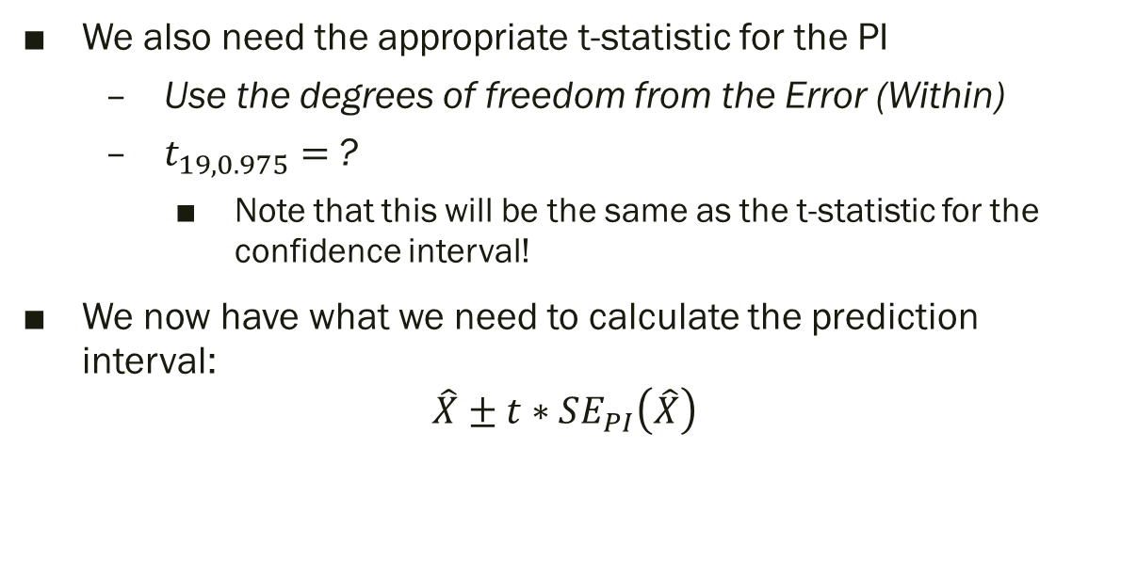
Calibration: Prediction Interval
We also need the appropriate t-statistic for the PI
Use the degrees of freedom from the Error (Within)
$t_{19, 0.975}=$?
Note that this will be the same as the t-statistic for the confidence interval!
We now have what we need to calculate the prediction interval:
$$\hat{X}±t∗SE_{PI}\left(\hat{X}\right)$$

Slide 26
Quiz 10 Review
Please write in your group notes that you have moved on to the Quiz.
This helps me know where people are and which groups I should check on.
Put any questions you have from the Quiz in your group notes

Slide 27
Question 1
A statistics student gathered data on a large numbers of cars of a particular model, from new cars to those that were up to 10 years old. Using the data on car ages (in years) and car prices (in US dollars) he found a linear relationship and produced the following regression model: Predicted Price = 5620 - 440 * Age. A friend asked him to predict the price of a 5 year old model of this car, using his equation. Which of the following is the most correct response to provide?
Plot a regression line, find 5 on the x axis, and read off the corresponding value on the vertical axis.
Substitute 5 in the equation for price and solve for age.
The equation cannot be used because there are many other determinants of a car’s price other than its age.
The equation cannot be used for a 5 year old car because no prices 5 year old cars were used to calculate the regression line.

Slide 28
Question 1 Answer
A statistics student gathered data on a large numbers of cars of a particular model, from new cars to those that were up to 10 years old. Using the data on car ages (in years) and car prices (in US dollars) he found a linear relationship and produced the following regression model: Predicted Price = 5620 - 440 * Age. A friend asked him to predict the price of a 5 year old model of this car, using his equation. Which of the following is the most correct response to provide?
Plot a regression line, find 5 on the x axis, and read off the corresponding value on the vertical axis

Slide 29
Question 2
Why can an R² close to one not be used as evidence that the simple linear regression model is accurate?
Select one:
R² reflects the degree of linear association; therefore, a value close to one indicates that the linear model is accurate.
R² should be close to 0 if the relationship is linear.
Even if R² is close to one, it is possible that nonconstant variance, curvature or outliers are present in the data
R² is close to one only if the relationship between X and Y is curved.

Slide 30
Question 2 Answer
Why can an R² close to one not be used as evidence that the simple linear regression model is accurate?
Even if R² is close to one, it is possible that nonconstant variance, curvature or outliers are present in the data

Slide 31
Question 3
In this unit, we talked about regression calibration. When is calibration used?
Select one:
When we accidentally switch the Y and X variables.
When we want to predict an expensive, precise measurement from an inexpensive, less accurate measurement
When we want to predict an inexpensive, imprecise measurement from an expensive, accurate measurement
When the assumptions of the regression equation are not met.

Slide 32
Question 3 Answer
In this unit, we talked about regression calibration. When is calibration used?
When we want to predict an expensive, precise measurement from an inexpensive, less accurate measurement

Slide 33
Question 4
At what value of X will there be the most precise prediction of a future Y?
Select one:
The mean of the Y’s
At the x-intercept
The precision will be the same for all X values.
The mean of the X’s

Slide 34
Question 4 Answer
At what value of X will there be the most precise prediction of a future Y?
The mean of the X’s

